Slide 1
Wrap up
Customer Analytics

Slide 2
Agenda
Evaluations (5 minutes)
Go to Canvas announcements and use that link.
Wrap up
Exam information
Q&A

Slide 3
What we covered in this class
Data &
Coding
Models & Concepts
Consumer
Behavior
skills needed for
Marketing Analytics

Slide 4
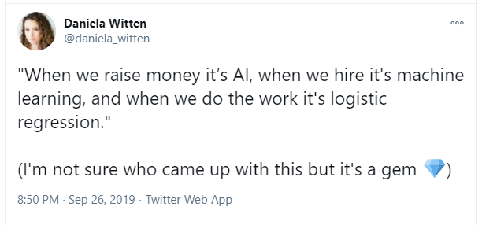
Always remember logistic regression

Slide 5
Exam Information
Canvas Module: Final Exam Fall 2021
Cover page
Formula sheet

Slide 6
Cover page: what can you use?
Only the following examination aids are permitted during the exam:
a. Formula sheet (to be downloaded directly from TestVision) b. Digital scrap paper in TestVision during the exam c. Computer programs: Microsoft Excel, R and R studio d. Data set files (to be downloaded directly from TestVision)

Slide 7
Cover page: exam content
The exam consists of 9 questions, divided into 4 blocks.
The points to be earned are indicated next to each question.
They sum up to 100. Next to that, there is one bonus question for which we will grade if you are close to (but below) the passing score.

Slide 8
Cover page: grading
As mentioned in the syllabus, you need a grade above 5 to pass.
The final grade is 70% exam and 30% assignments, which you have already completed.
The expected passing score (the score to pass the exam) is 55 points.

Slide 9
Cover page: providing answers
You will provide the answers on TestVision itself. Material submitted on paper or via any other channels will not be graded
In terms of open-ended questions, use the relevant concepts we discussed in this course and limit your answer to the maximum number of words indicated. Write clearly and concisely, supporting your answer with good arguments. Quality is more important than quantity when it comes to supporting arguments.

Slide 10
Cover page: exam advice
When you are having a hard time with a question, move on to the next one so that you avoid losing valuable time. Come back to the difficult question after you have completed the rest of the exam.
Be careful with the ready button. Do not click on it before you have finished the exam.

Slide 11
Cover page
Exam grades and inspection will be announced on Canvas.
See all exam instructions on Canvas

Slide 12
Questions
6 calculation and 3 concept questions intermingled.
Some involve coding in R, some involve interpreting output
You’ll get a starter .Rmd file to help you out with these questions
You’ll have to create your own formula (Y ~ X), but not that functions like predict(formula = …, type = …, newdata = …)
See practice exam question on Canvas to get an idea

Slide 13
What to study
1. Lecture slides (most important)
2. Assignments (important)
3. Background reading (can help)
But, content has to be in the lecture/assignment to be on the test. There is nothing on the exam from background reading that we did not cover in lecture/assignment.

Slide 14


